Slide 1
Chapter 3
Motion and Acceleration
3.2

Slide 2
3.2 Acceleration
Think about a car at a stop light
When the light turns green, the car starts moving and the car’s velocity increased
The car began accelerating
Acceleration is the change in velocity divided by the time it took the change to occur

Slide 3
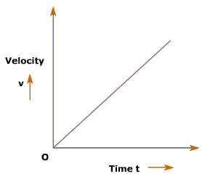
3.2 Acceleration
Acceleration can be positive, negative, or zero depending on whether the object is speeding up, slowing down, or remaining at a constant speed
Because the velocity/speed of this object is increasing over time, this means there is a positive acceleration.
Ex: ball coming down from a bounce, a car when a traffic light turns green, coming down hill on a bike

Slide 4
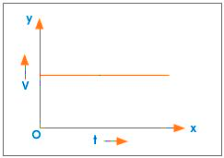
3.2 Acceleration
Acceleration can be positive, negative, or zero depending on whether the object is speeding up, slowing down, or remaining at a constant speed
This represents an object that has a constant speed. It is not speeding up or slowing down, so it has zero acceleration.
Ex: a car that is on the highway doing a constant speed

Slide 5
3.2 Acceleration
Acceleration can be positive, negative, or zero depending on whether the object is speeding up, slowing down, or remaining at a constant speed
Because the velocity/speed of this object is decreasing over time, this means there is a negative acceleration.
Ex: riding your bike uphill, ball bouncing upward (gravity is slowing it down as it travels up)

Slide 6
3.1 Acceleration
Calculating Acceleration
vf = final velocity; vi = inititial velocity
tf = final time; ti = initial time
Units are in meters per second² (m/s²)
If an object begins acceleration from rest or a standstill, its initial time is 0
If you get a negative value for acceleration, it means the object is slowing down

Slide 7
3.1 Acceleration
Example
A jet airliner starts at rest and moves down the runway in a straight line. After accelerating for 20 seconds, it reaches a speed of 80 meters per second.
Calculate the jet’s average acceleration. Is it positive or negative? What does that mean?
vf = final velocity =
vi = initial velocity =
tf = final time =
ti = initial time =

Slide 8
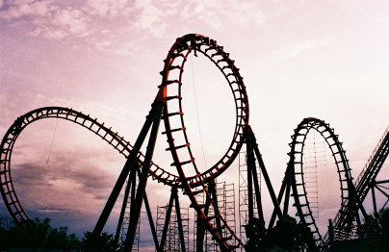
3.1 Acceleration
I know what you’re thinking...“this is SUPER interesting and all Ms. T., but what does this have to do with anything?”
If you like the thrill of riding roller coasters, you can thank physics, especially acceleration, for that
The steep hills and inversion loops provide large acceleration towards the ground due to gravity
When you go around a sharp turn, acceleration is also increasing…that’s why you feel that push against the side of the car!

